Slide 1

NEEDFINDING
Neil Iverson Sarte / Carl James Rosalita

Slide 2

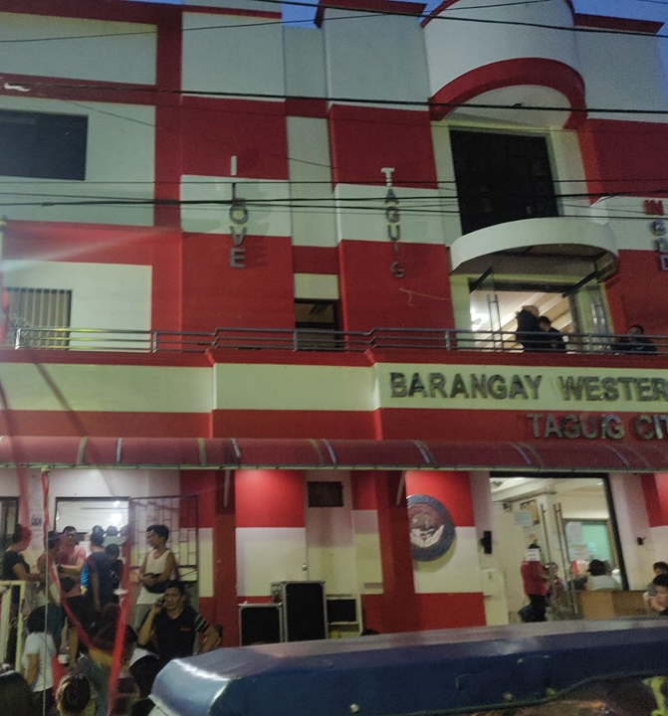
What Activity did you choose to examine?
We chose to examine the process of getting documents from the Barangay, like Barangay Clearance, Business Permit, Construction Clearance etc.
We went to our respective Barangays (Western Bicutan, Pinagsama) to see and observe their process of issuing Barangay documents

Slide 3
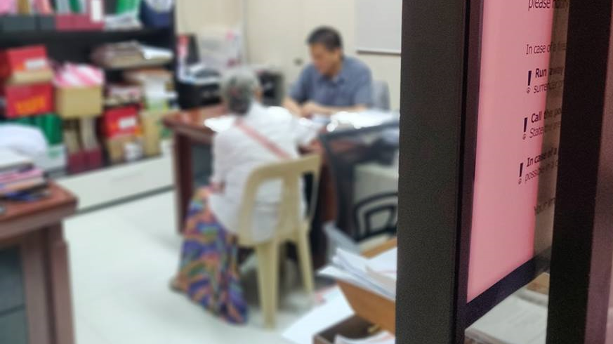
How do you Examine it, with what Methods?
In order to fulfill the activity, we went to our respective Barangays (Western Bicutan, Pinagsama) to see and observe their process of issuing Barangay documents.
We also conducted informal interviews to numerous Barangay Officials and also some of the residents whose requested certain documents.
We also observe what is happening on lobby, where the residents are requesting the documents.

Slide 4
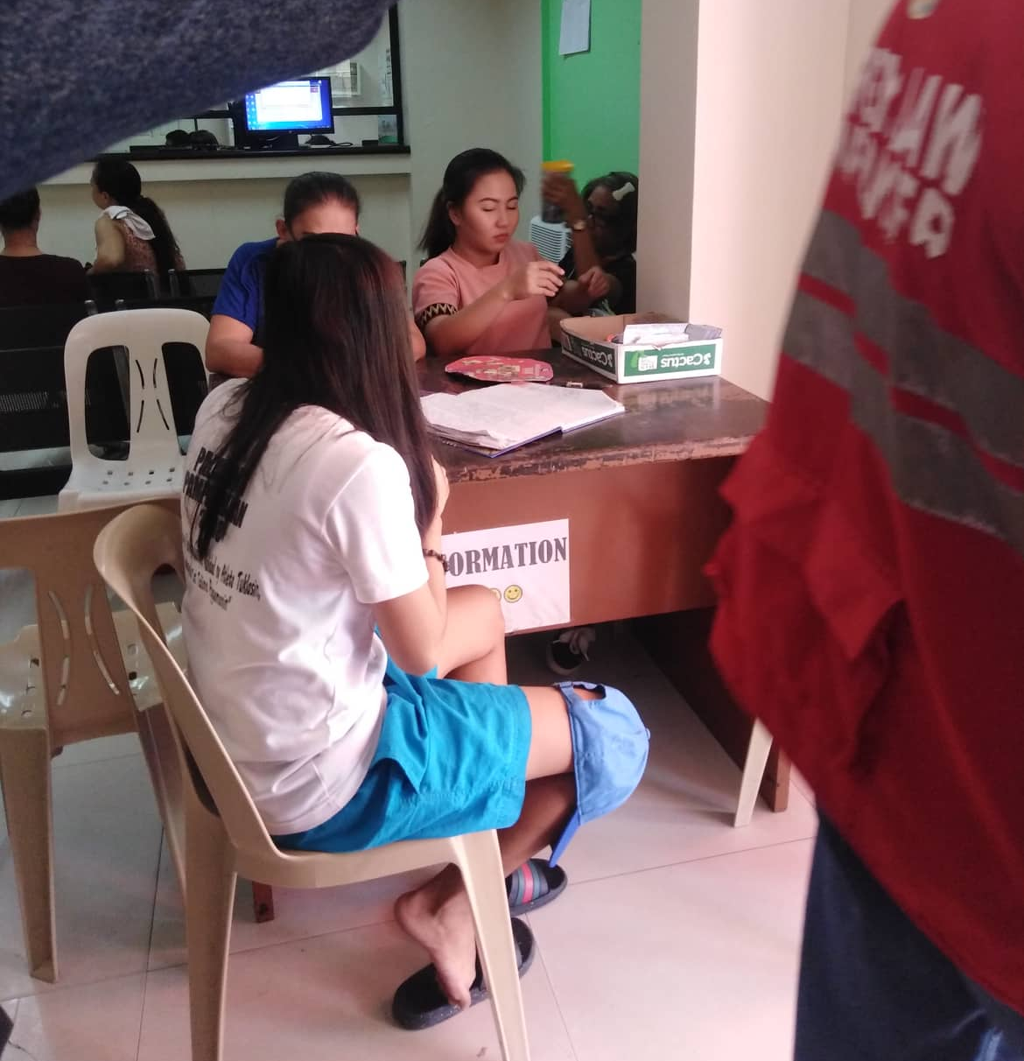
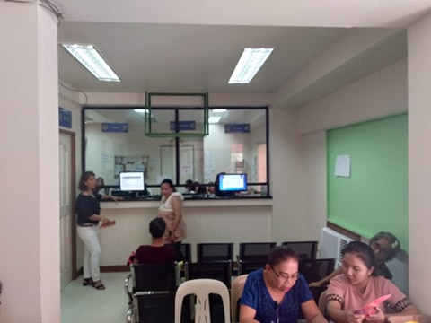
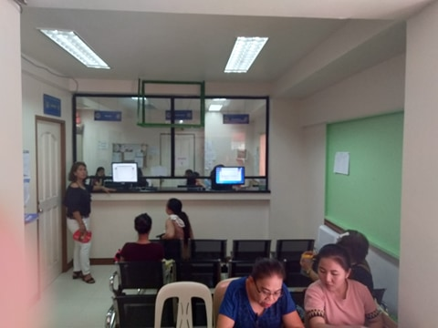

Slide 5
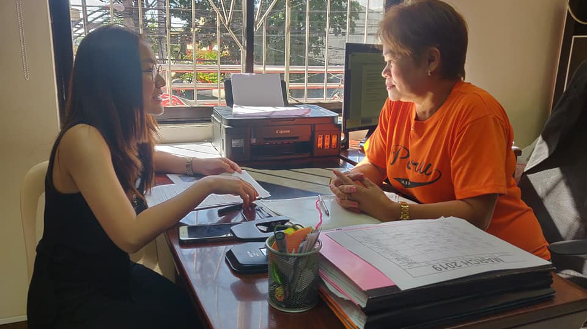
What major insights or breakdowns did you discover?
We interview one of the barangay officials about the current flow about requesting and issuing documents.
There are about 10 to 12 people are going to the Barangay Hall to request documents to them, mostly Barangay Clearance.
The Barangay usually requires an authorization letter in order for the residents to request a document
The authorization letter mainly issued by the Barangay Officials that has the power to issue such one, most notably the Barangay Councilors and the Barangay Captain.
The authorization letter serves also as the proof that an individual is a resident of the Barangay.
Those officials usually are not around the Barangay Hall for most of the time, usually during office hours.
The residents now tends to find atleast one official to issue them an authorization letter.

Slide 6
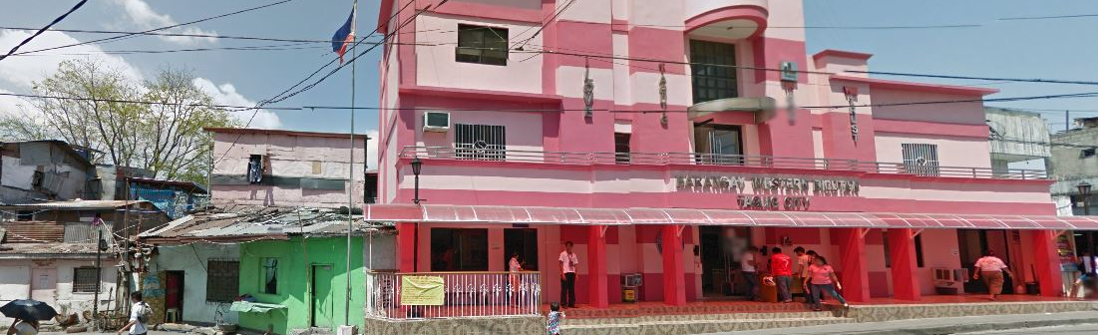
What promising unmet needs were identified as a result?
The Barangay needs to have a way where the individuals will go directly to the Barangay Hall to verify whether or not he/she is a bonafide resident of the Barangay
The Barangay needs to have an alternative to the authorization letter, since the letter serves as a proof that the individual is a resident of the barangay. And also to eliminate the time that is consumed by just finding a proper Brgy. Official to issue them a letter.

Slide 7
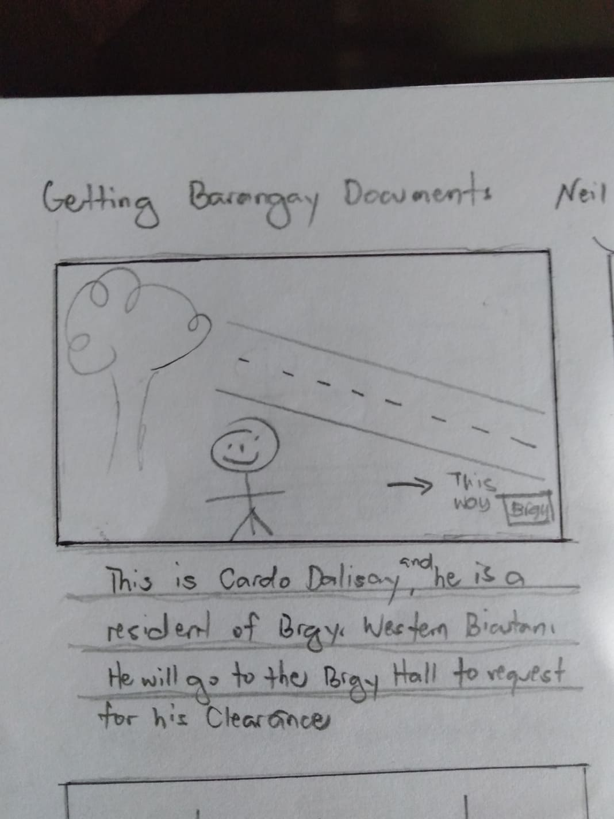
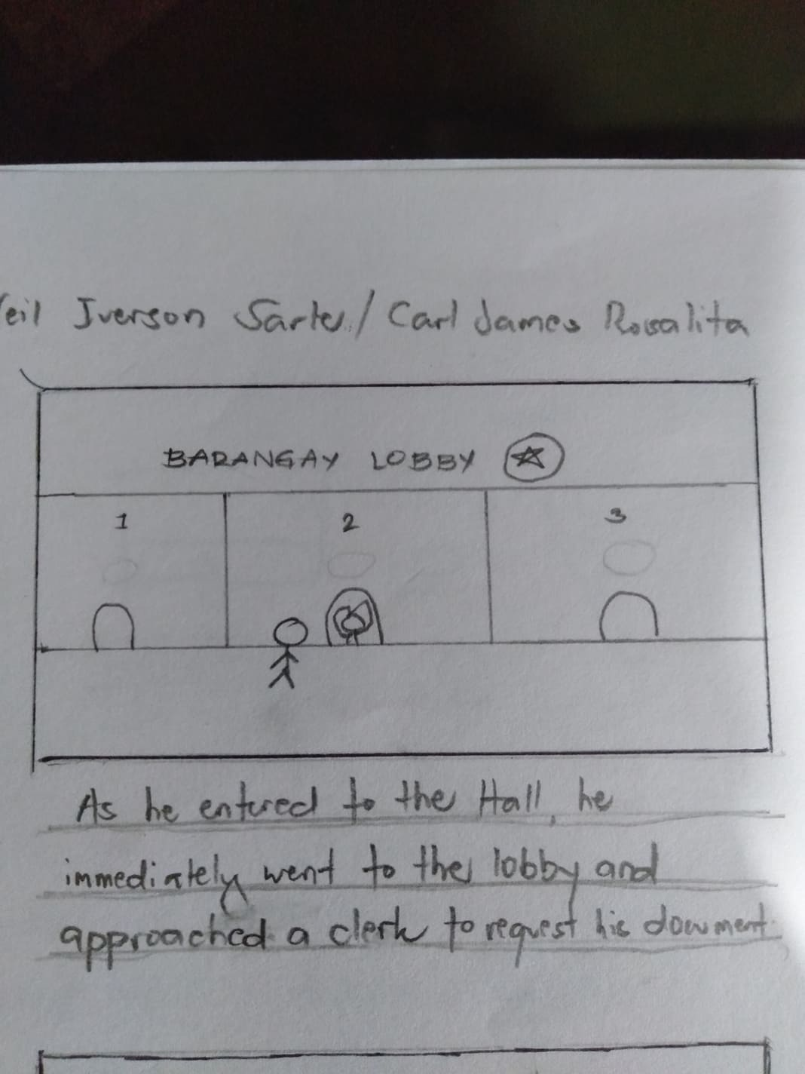
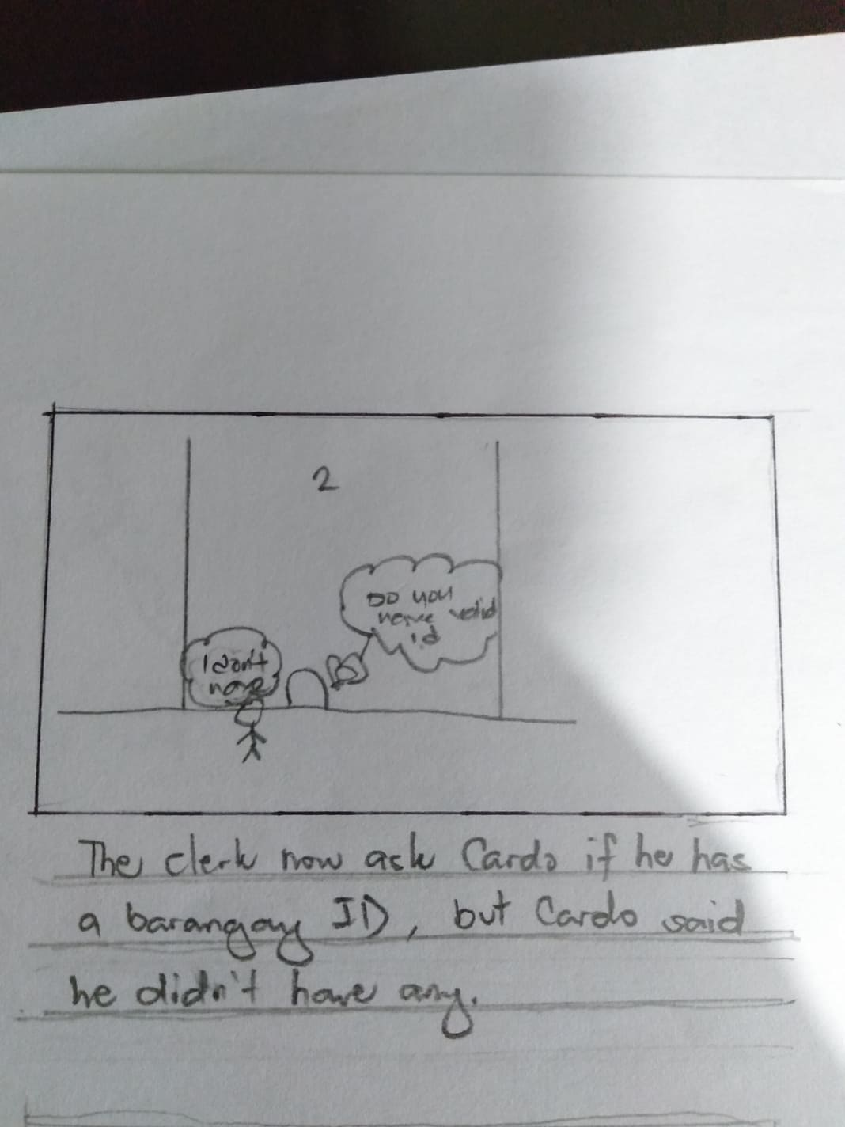
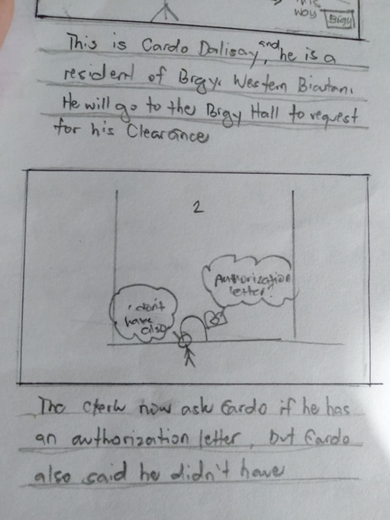
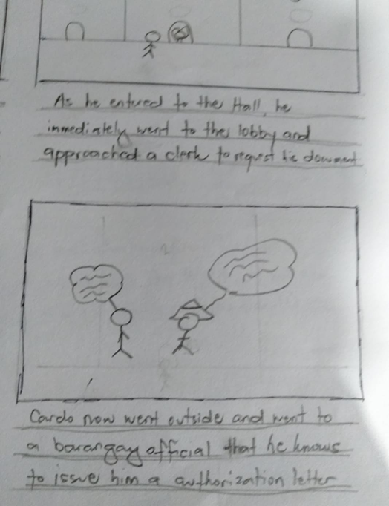
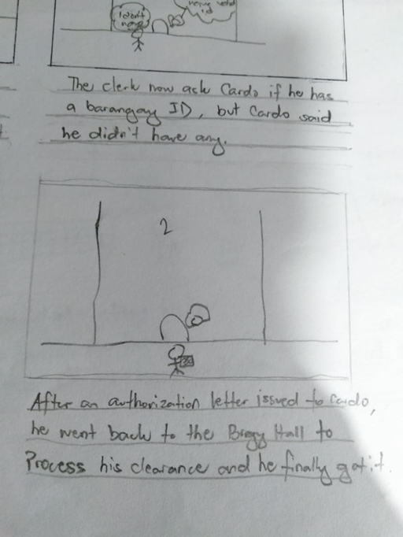
Storyboard 1

Slide 8
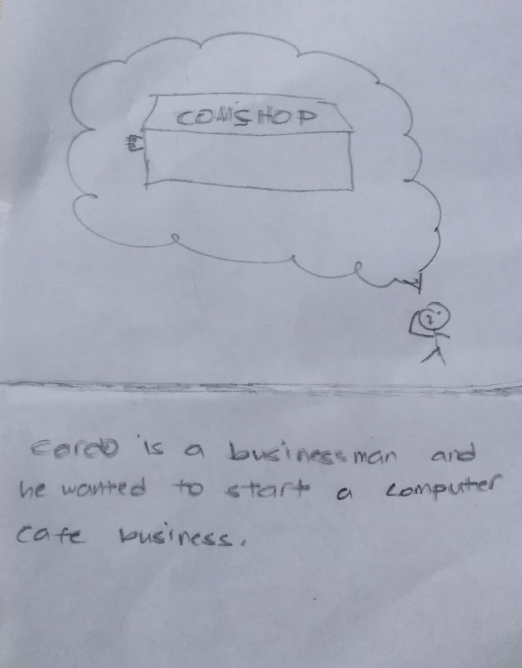
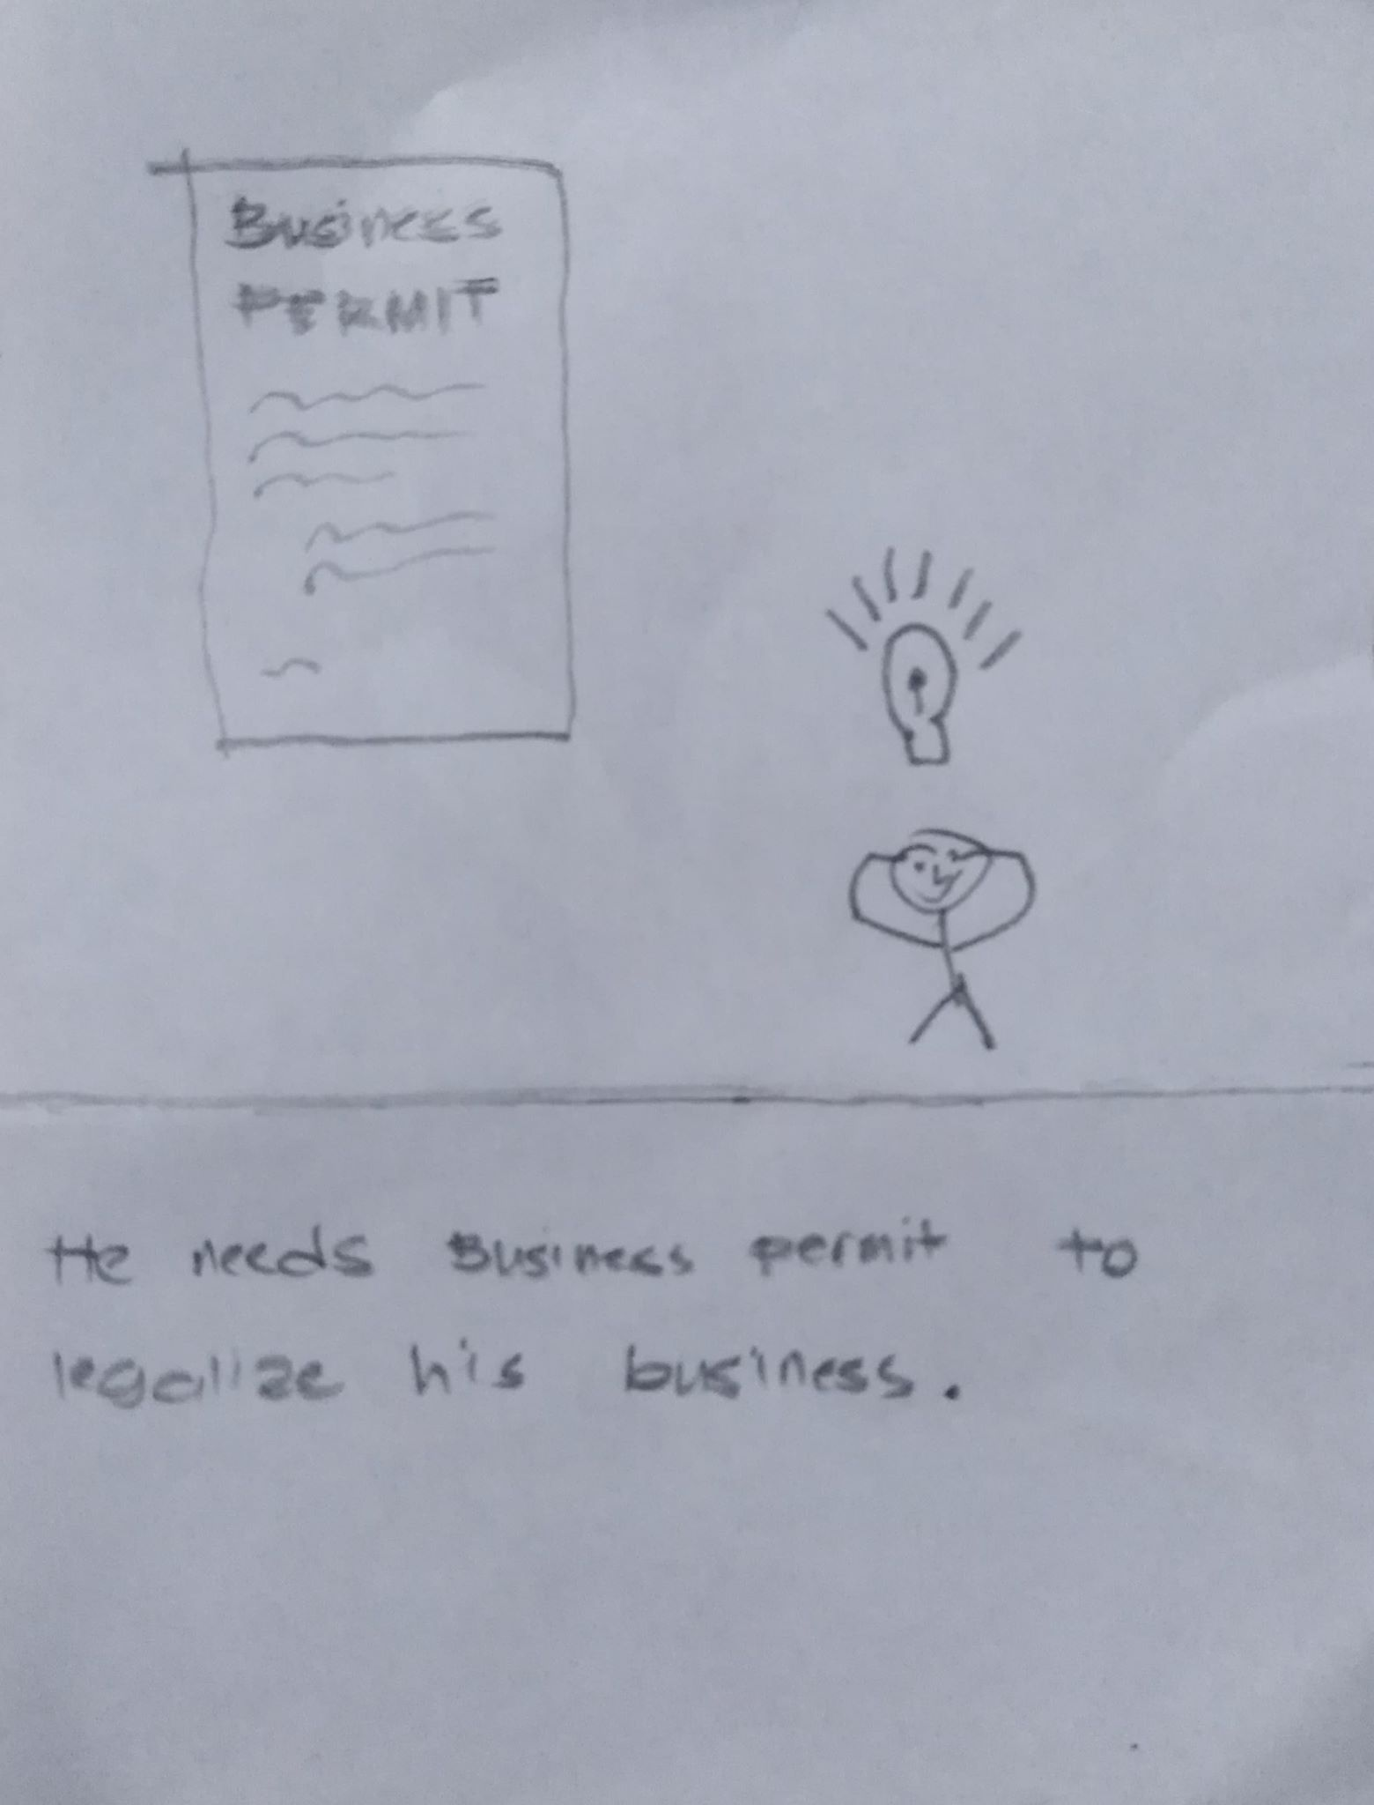
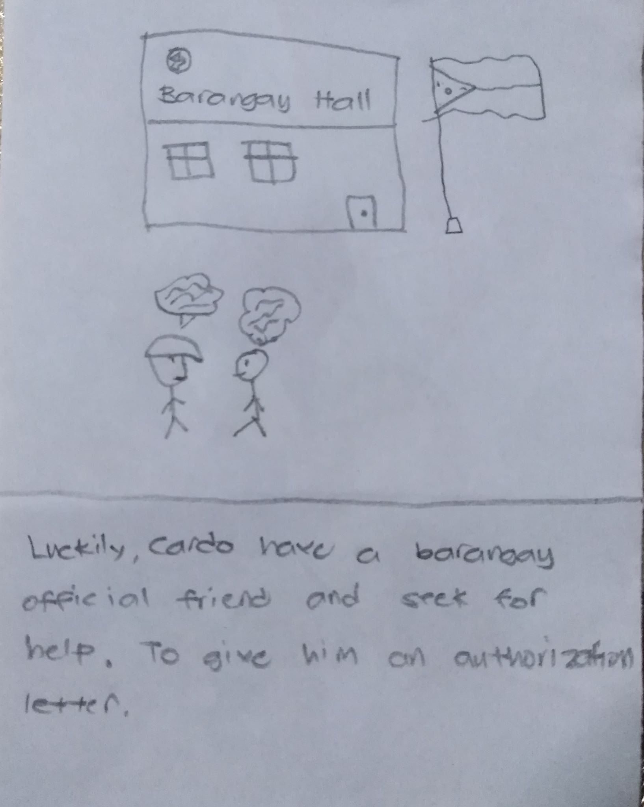
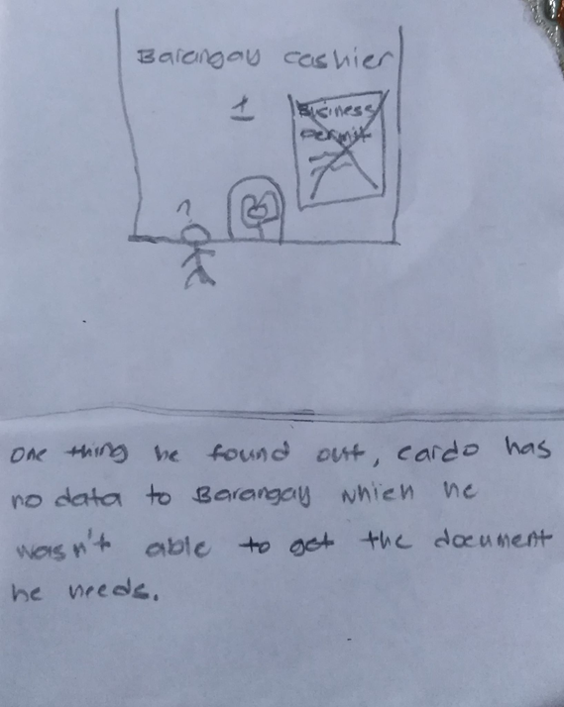
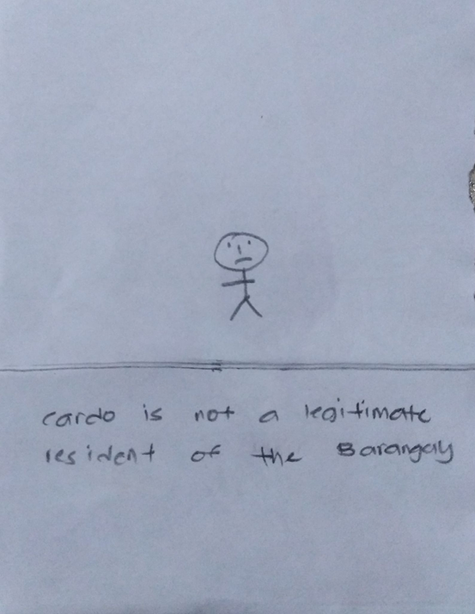
Storyboard 2

Slide 9
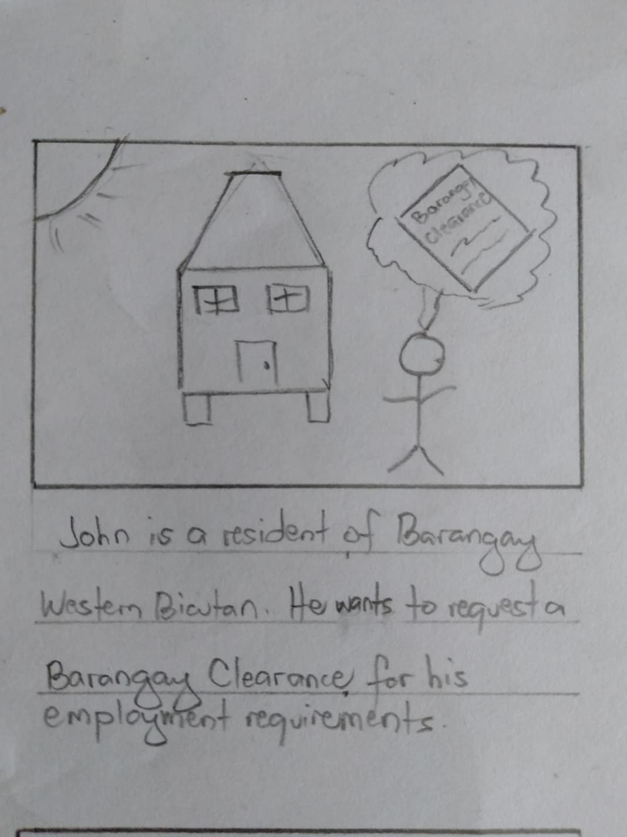
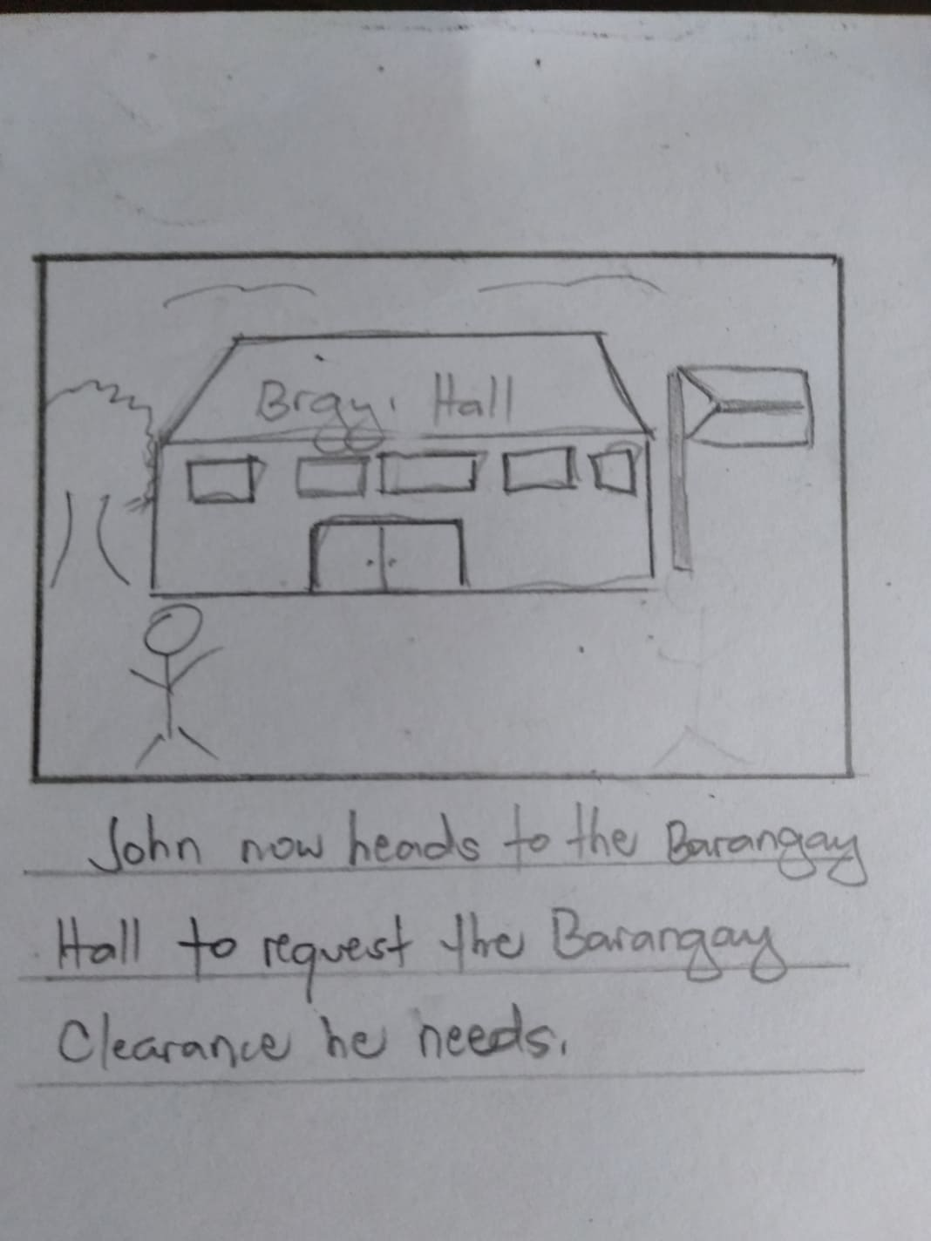
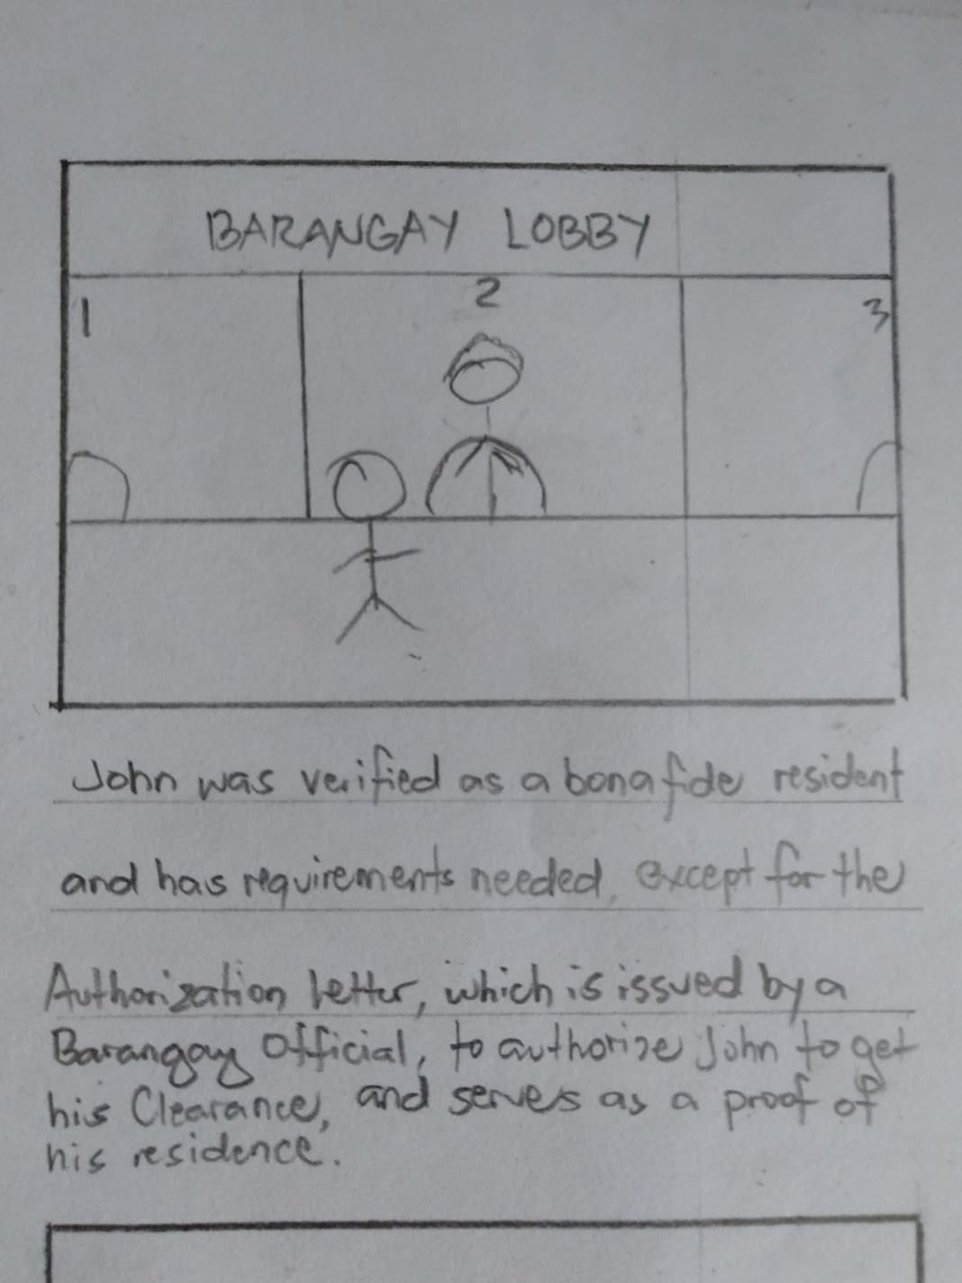
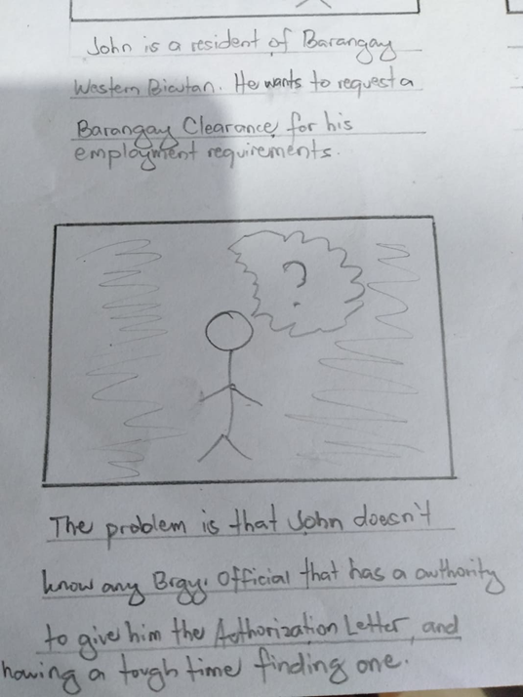
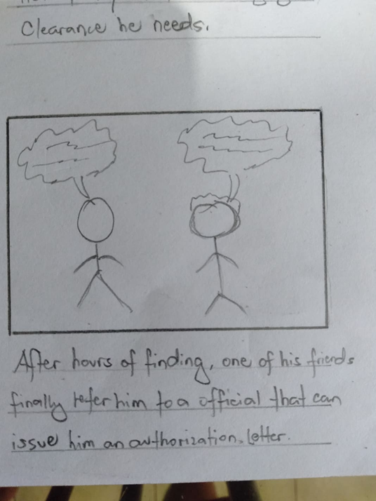
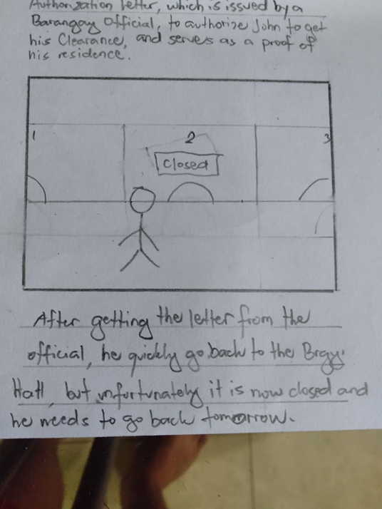
Storyboard 3

Slide 10
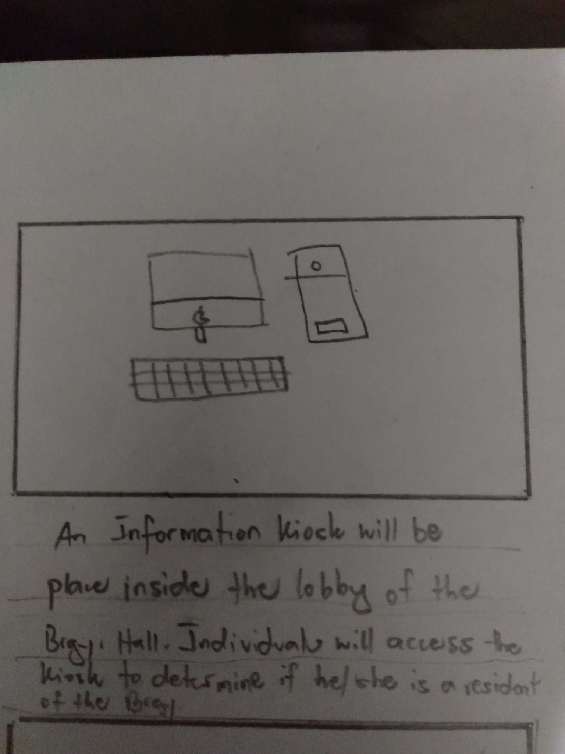
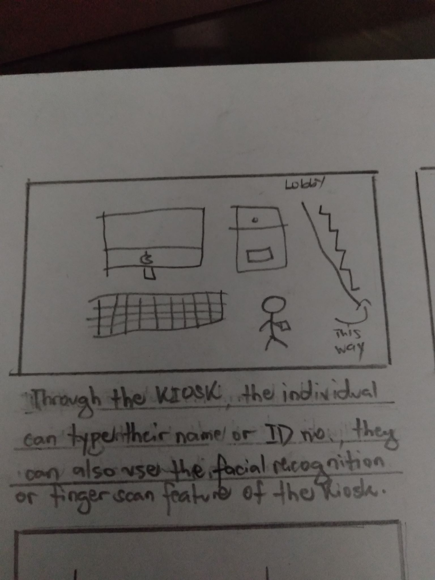
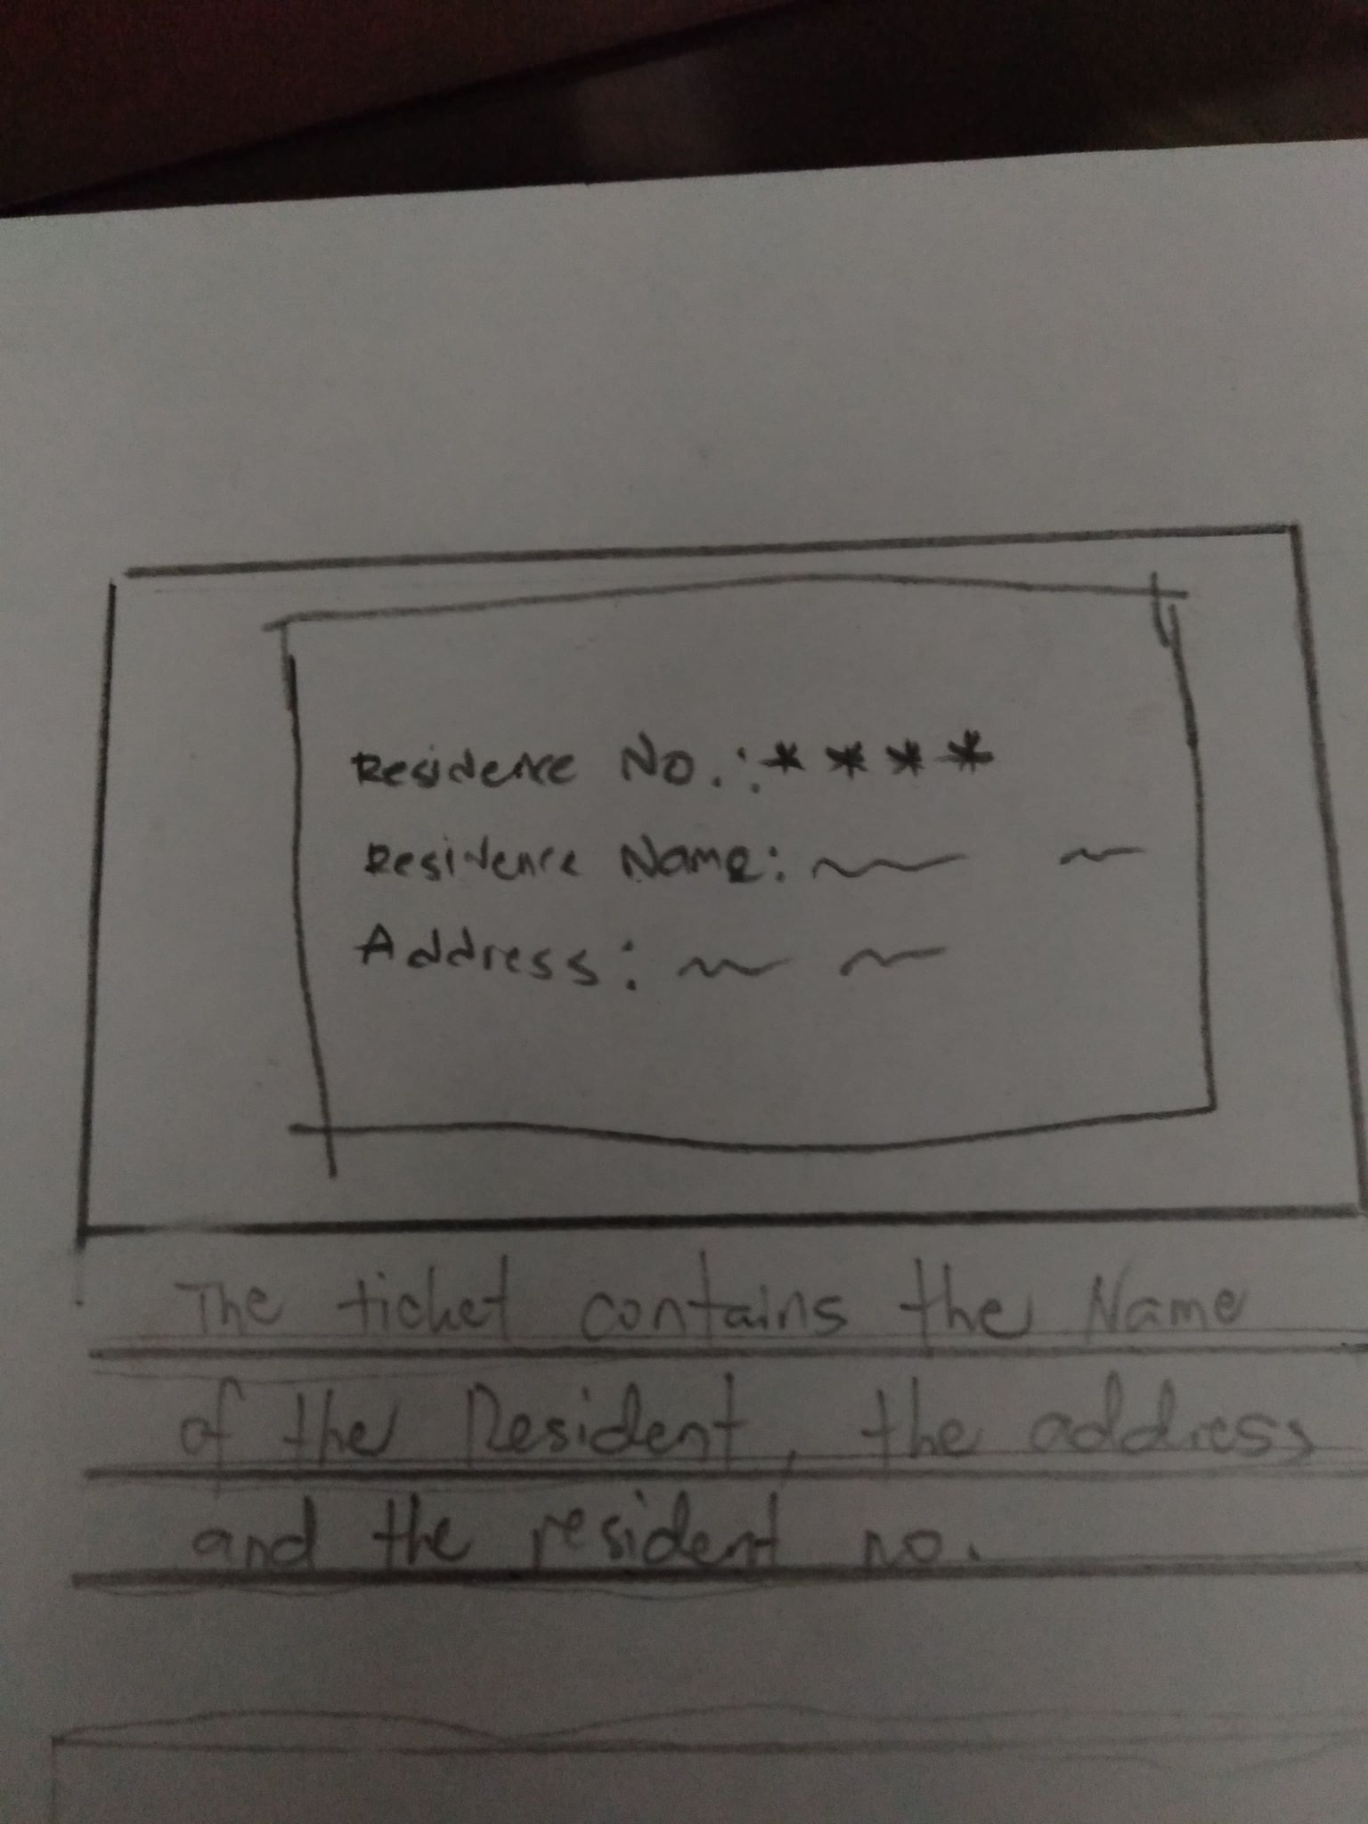
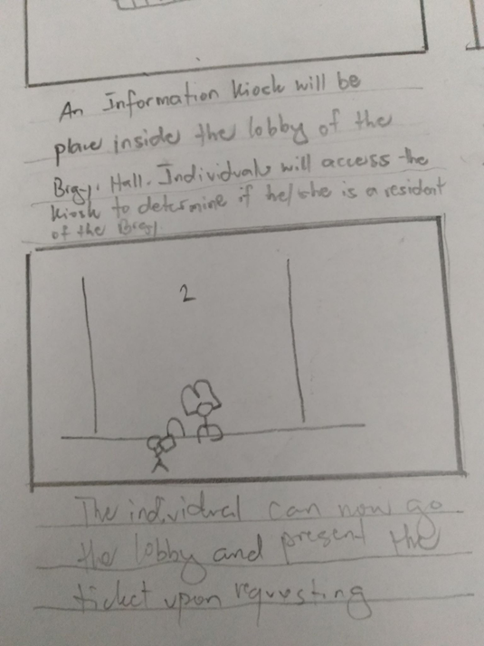
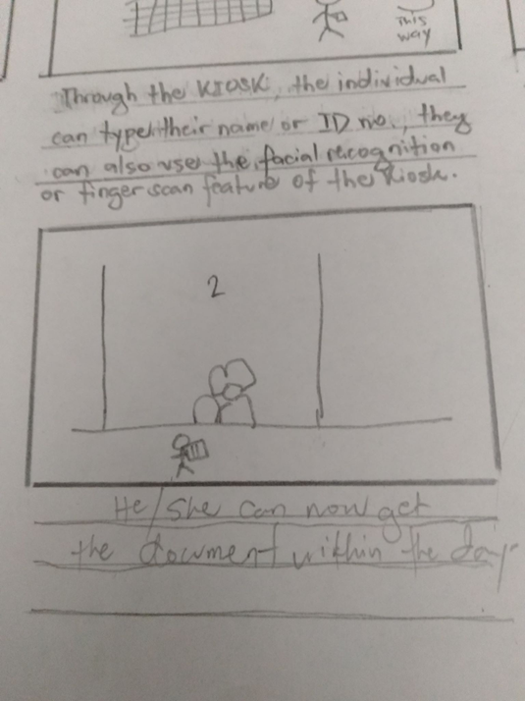
Storyboard 4

Slide 11
Paper Prototype

Slide 12
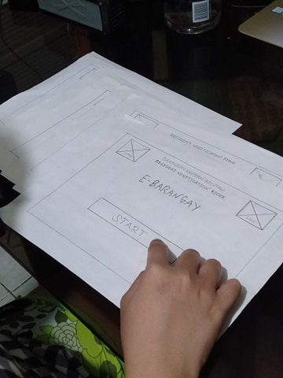
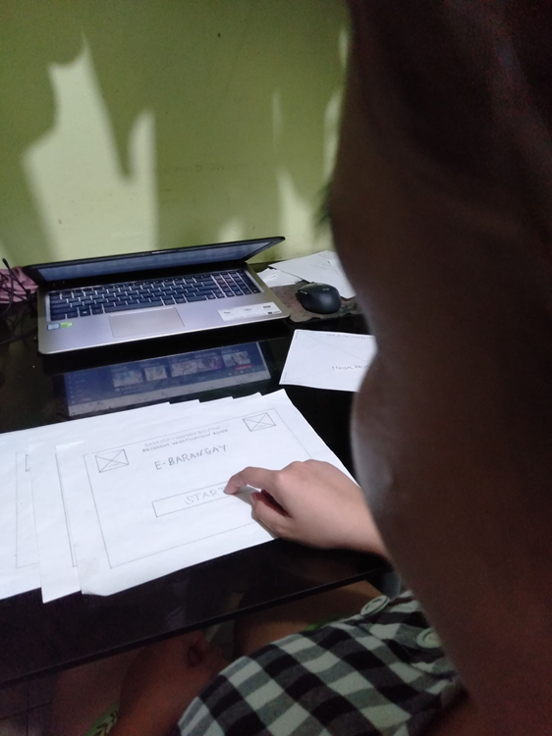
Testing Process

Slide 13
Comments, Feedbacks and Suggestions
“The application is super easy to navigate and understand”
“The application’s features, the facial recognition and fingerprint scan, is sketchy in my opinion, but it would be an great addition if it will be implemented properly.”

